Slide 1
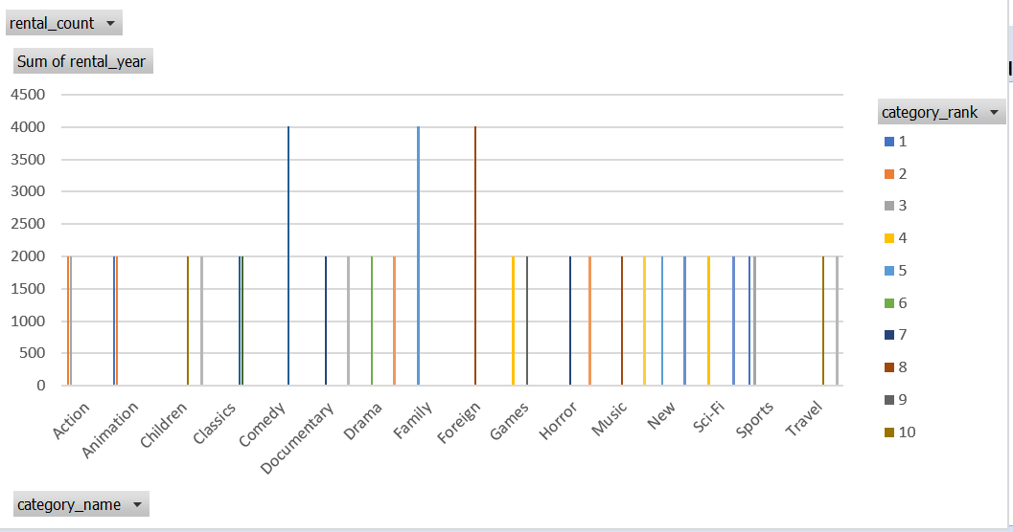
Query1
Question 1: What are the 5 most popular film categories each year, taking into account changes in popularity over the years?
Purpose: To analyze trends in customer preferences over time. Aggregation functions: COUNT, RANK (or ROW_NUMBER) Other SQL techniques: EXTRACT (to get the year of the lease date), PARTITION BY, ORDER BY
<visualization>

Slide 2
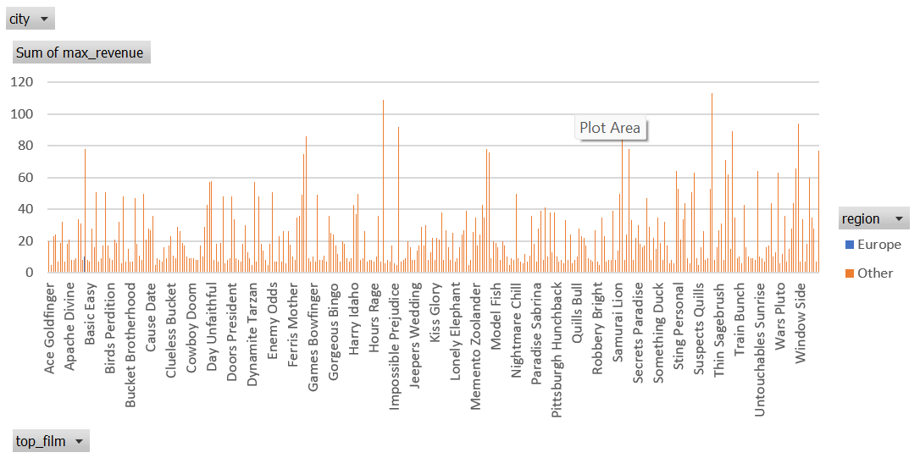
Query 2
Question 2: What are the films with the highest rental revenues in each city, ranked by region?
Purpose: To determine the most profitable films in each geographic region. Aggregation functions: SUM, MAX, DENSE_RANK Other SQL techniques: JOIN (join multiple tables), CASE (to classify cities into regions)
<visualization>

Slide 3
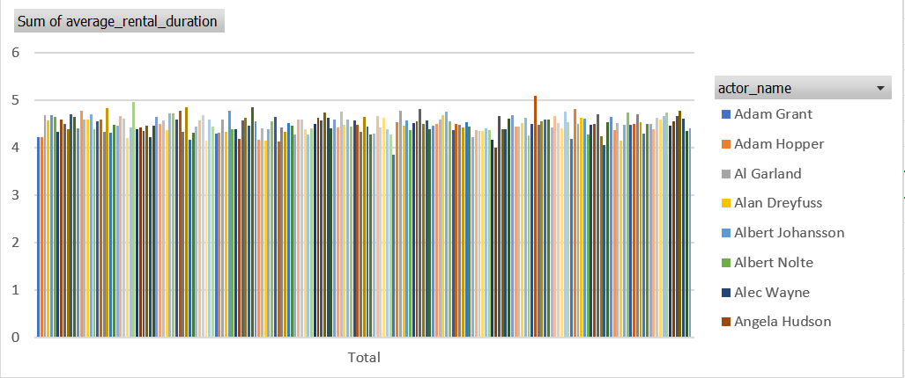
Query 3
Question 3: What is the average rental length (in days) per actor, considering only films longer than 120 minutes?
Purpose: To analyze the performance of actors based on the average rental duration of their feature films. Aggregation functions: AVG, DATE_PART Other SQL techniques: JOIN, WHERE (to filter by movie duration)
<visualization>

Slide 4
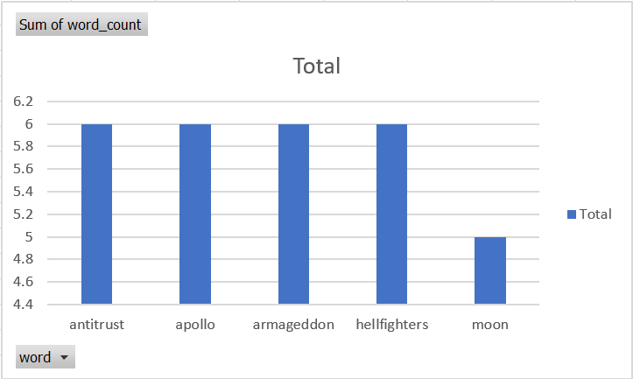
Query 4
<visualization>
What are the 5 most common words in movie titles, excluding common words like "the", "a", "an", etc.?
This query aims to analyze patterns in movie titles and identify the most frequently used words in them, while excluding common words that do not have a strong semantic meaning.

